Slide 1

Executive Summary
Tellaporte was conceived to use only cloud native functions in order to speed development and increase capability
Nurses are smart and have financial resources, but do not have time or inclination to manage their portfolio
Chatbot provide the perfect interface for users with limited PC access

Slide 2

Telleporte
The Future of Investing for Healthcare Heroes
Pete Petersen
Dakota Braxton

Slide 3

Creating your portfolio
Creating and managing your “Telleportfolio” is as easy and simple as ordering your favorite Starbucks beverage or shopping on amazon. Due to app integration and 24/7 Artificial intelligence support via 1-800 number or in app Q&A.
Notes:
Creating a profile is as simple as ordering a coffee or shopping on amazon due to a telleporte app available on Android , apple IOS devices or 1-800-Telleporte. Making it quick and easy so less time is taken away from personal time spent with family or partaking in self caré. Afterall, the last thing we as nurses want to do is spend half the day AKA 12hrs caring fro a patient and family just to come home and spend additional hours upon end creating a teleportfolio and (or) managing it. What a turn off that would be!

Slide 4

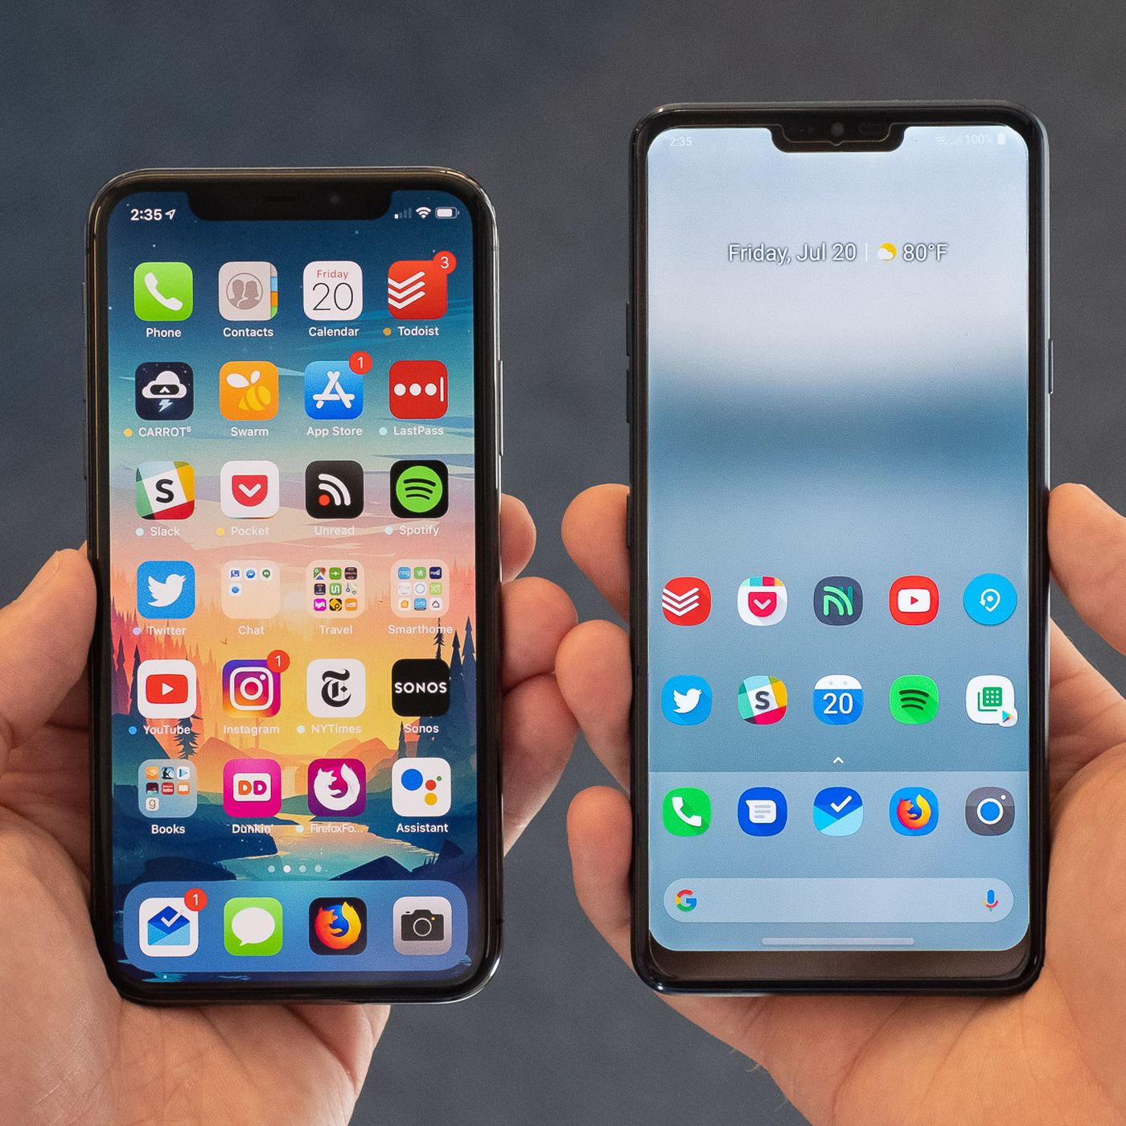
Managing your Portfolio
Notes:
No matter how you choose to manage your portfolio, we’ve got you covered!

Slide 5
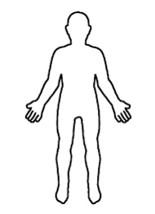
The Future of Investing for Healthcare Heroes

Slide 6

Where Finance Meets Familiarity
Telleportfolio Avatar
Your Telleportfolio avatar will display your assets in the order of importance that YOU deem necessary in a Head-to-Toe fashion, Mimicking how you would normally assess your patient on the daily.
Notes:
Your Telleportfolio avatar will display your assets in the order of importance that YOU deem necessary in a Head-to-Toe fashion, Mimicking how you would normally assess your patient on the daily.

Slide 7
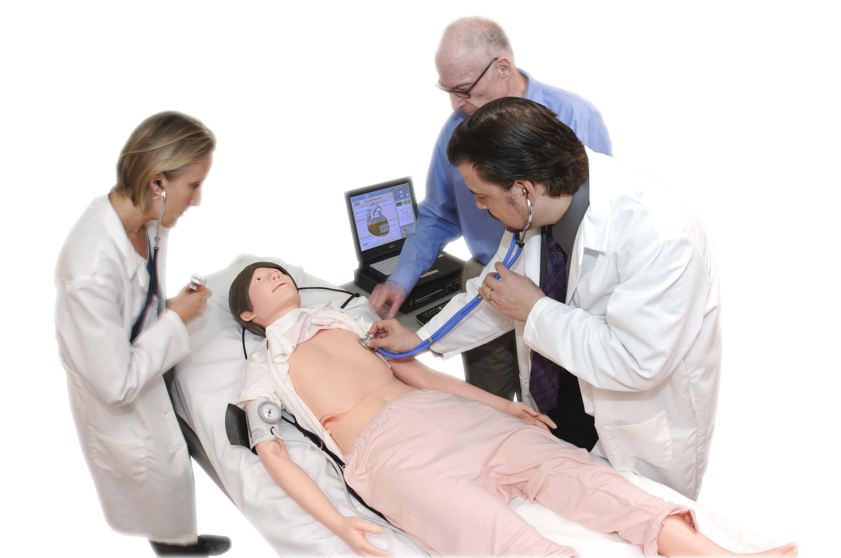

Bradycardic or Hemorrhaging Telleportfolio?…No Problem
RRT is here to help and notify you of any impending doom to your Teleportfolio
RRT is here to help and notify you of any impending doom to your Telleportfolio
Telleporte Codes are here to help!

Slide 8
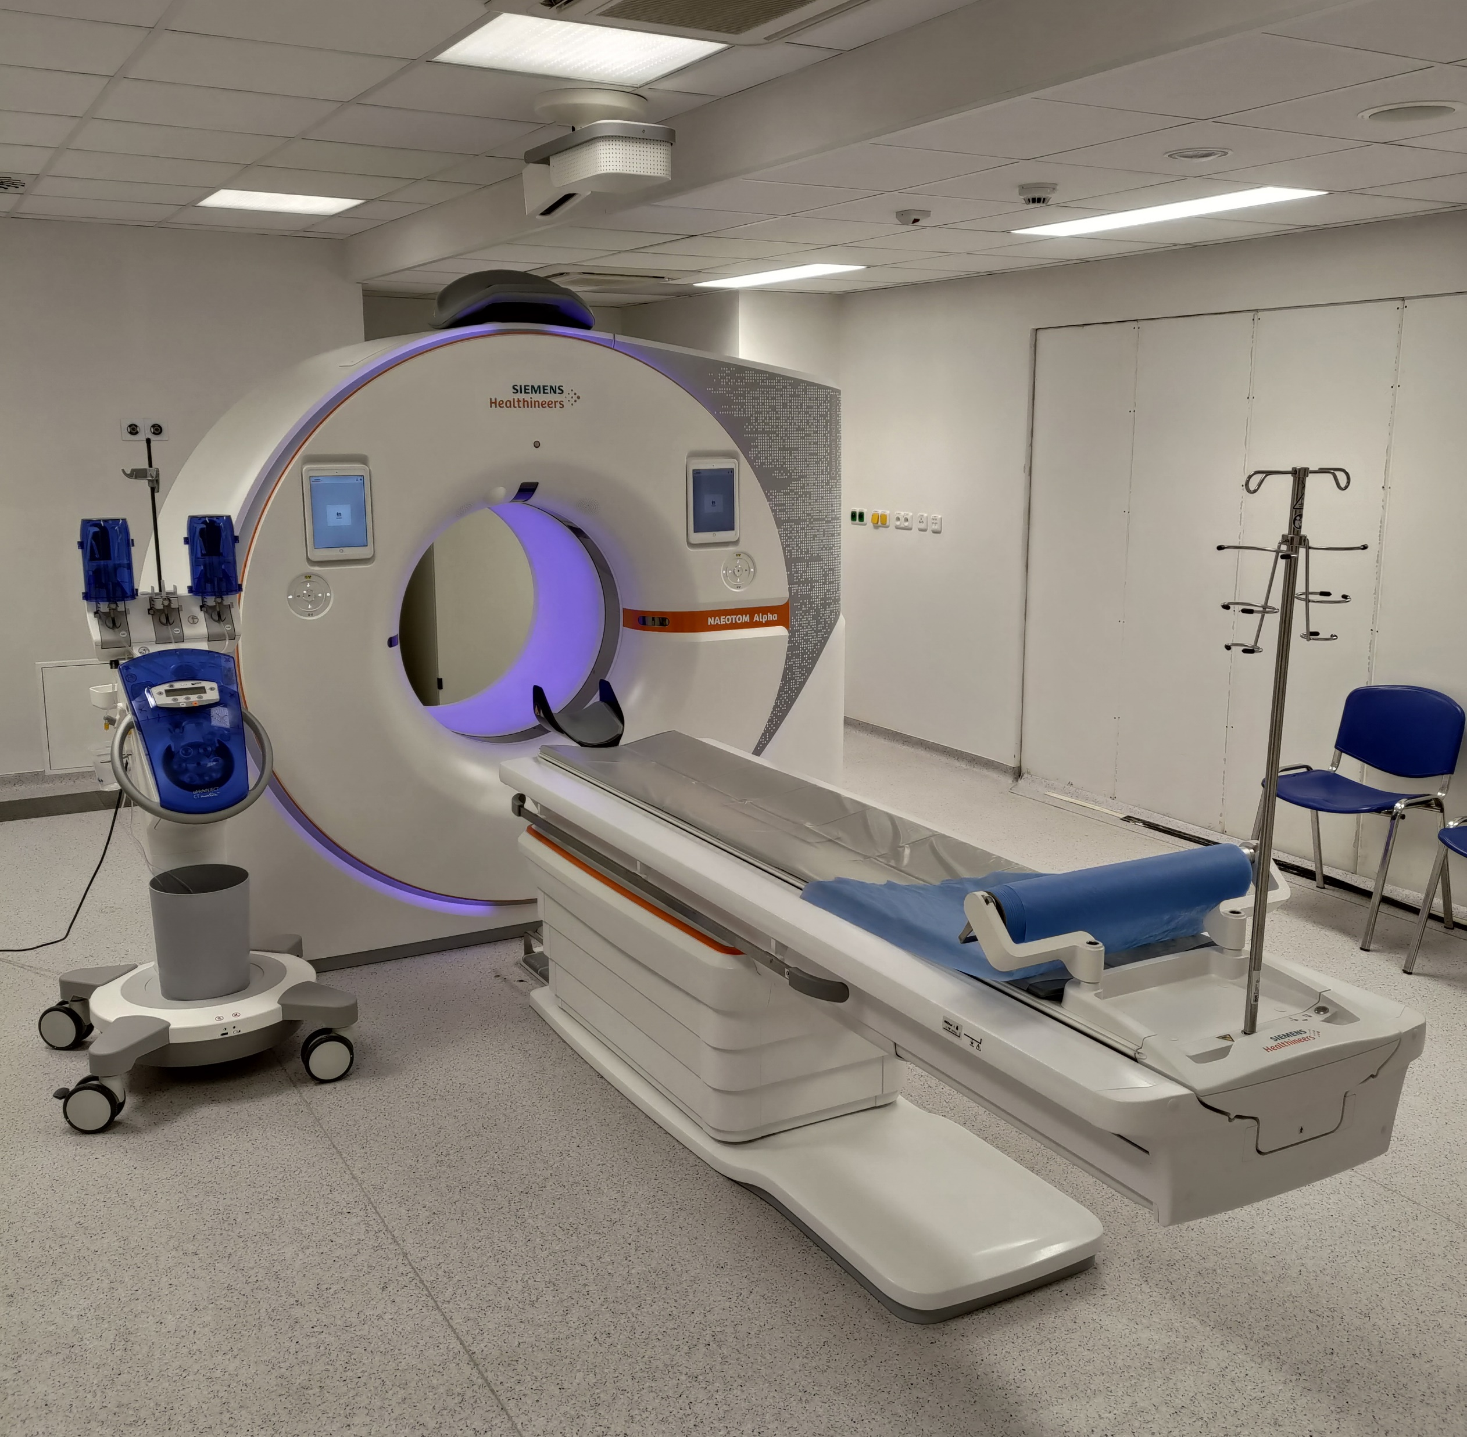
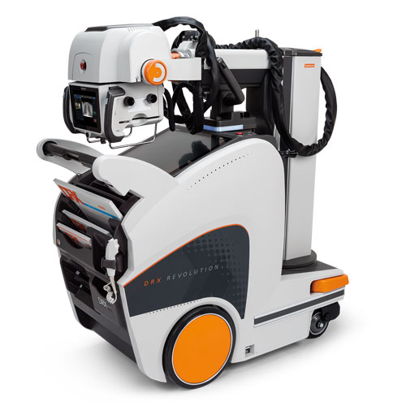
Imaging
CT
XRAY

Slide 9

Capital Triaging

Slide 10

Retire the way you want with Tellaport Thank you!!

Slide 11

Demo Time

Slide 12

Our Approach, Challenges
We chose to focus on a proof of concept application architecture and interface.
We thought the ML and clustering techniques were not the main problem. Accessibility is
SO...
We just built it in Amazon
Here is the repo:
https://github.com/petepetersen423/tellaport_v2

Slide 13
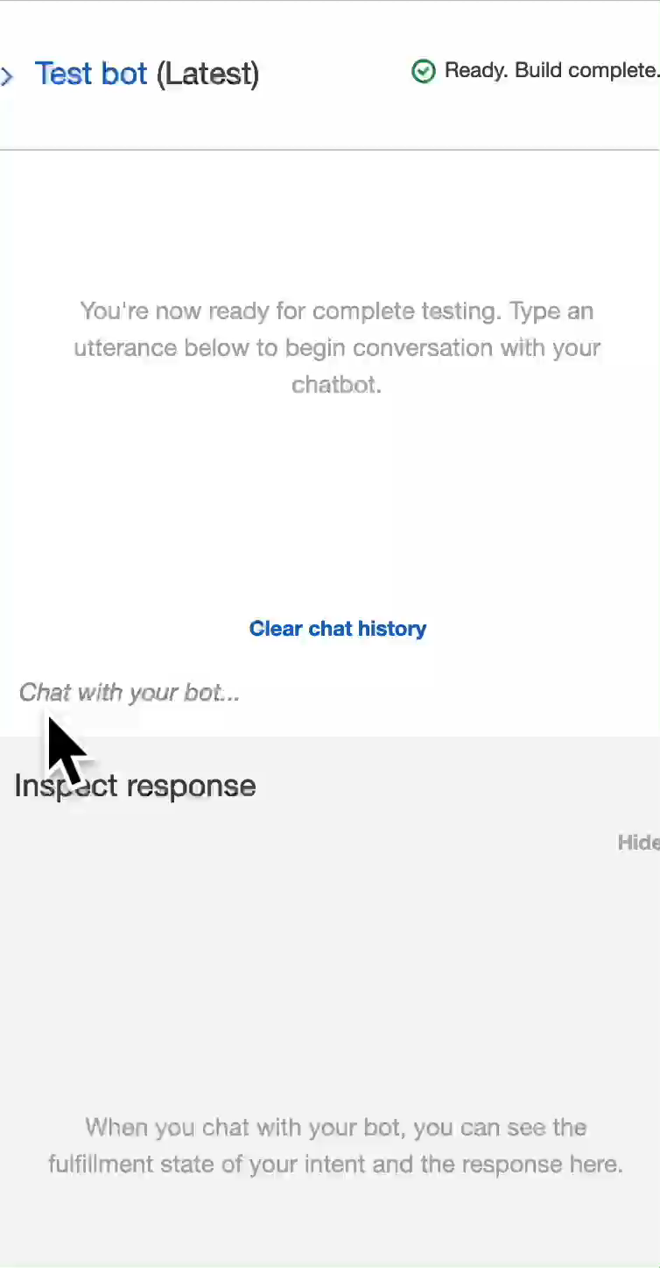
Sample Interaction Video

Slide 14


Sample Interactions
Sample Audio Call

Slide 15
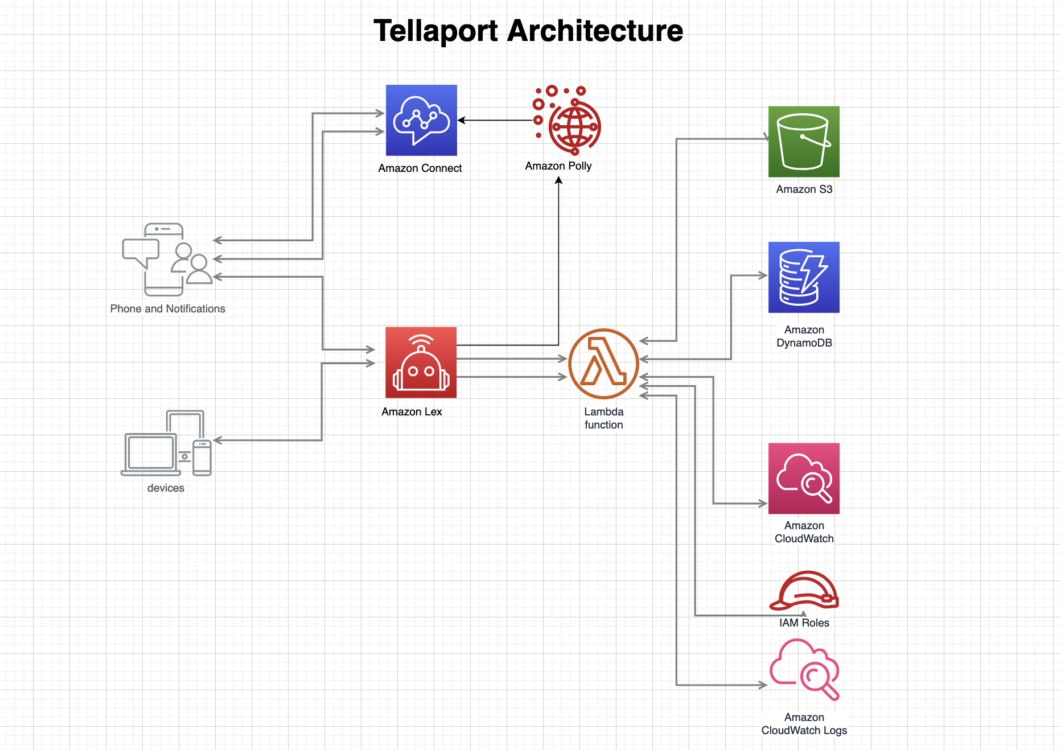
Tellaport Robo Advisor
Architecture

Slide 16
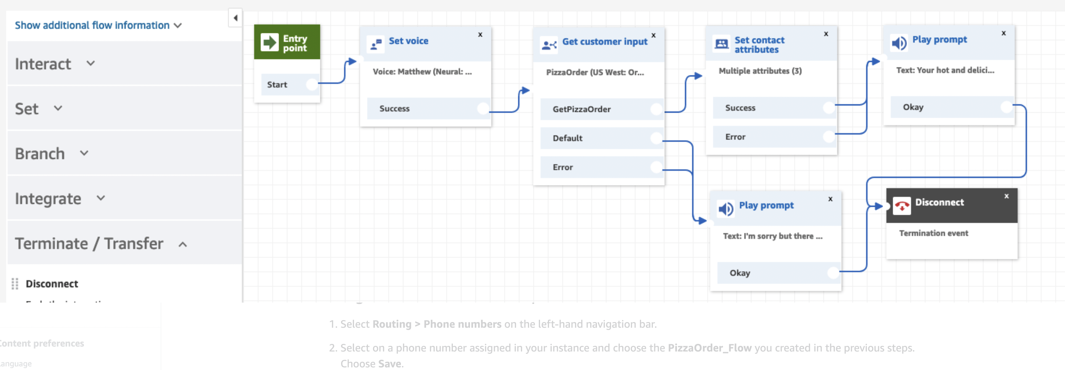
Amazon Contact Flow – using Polly

Slide 17
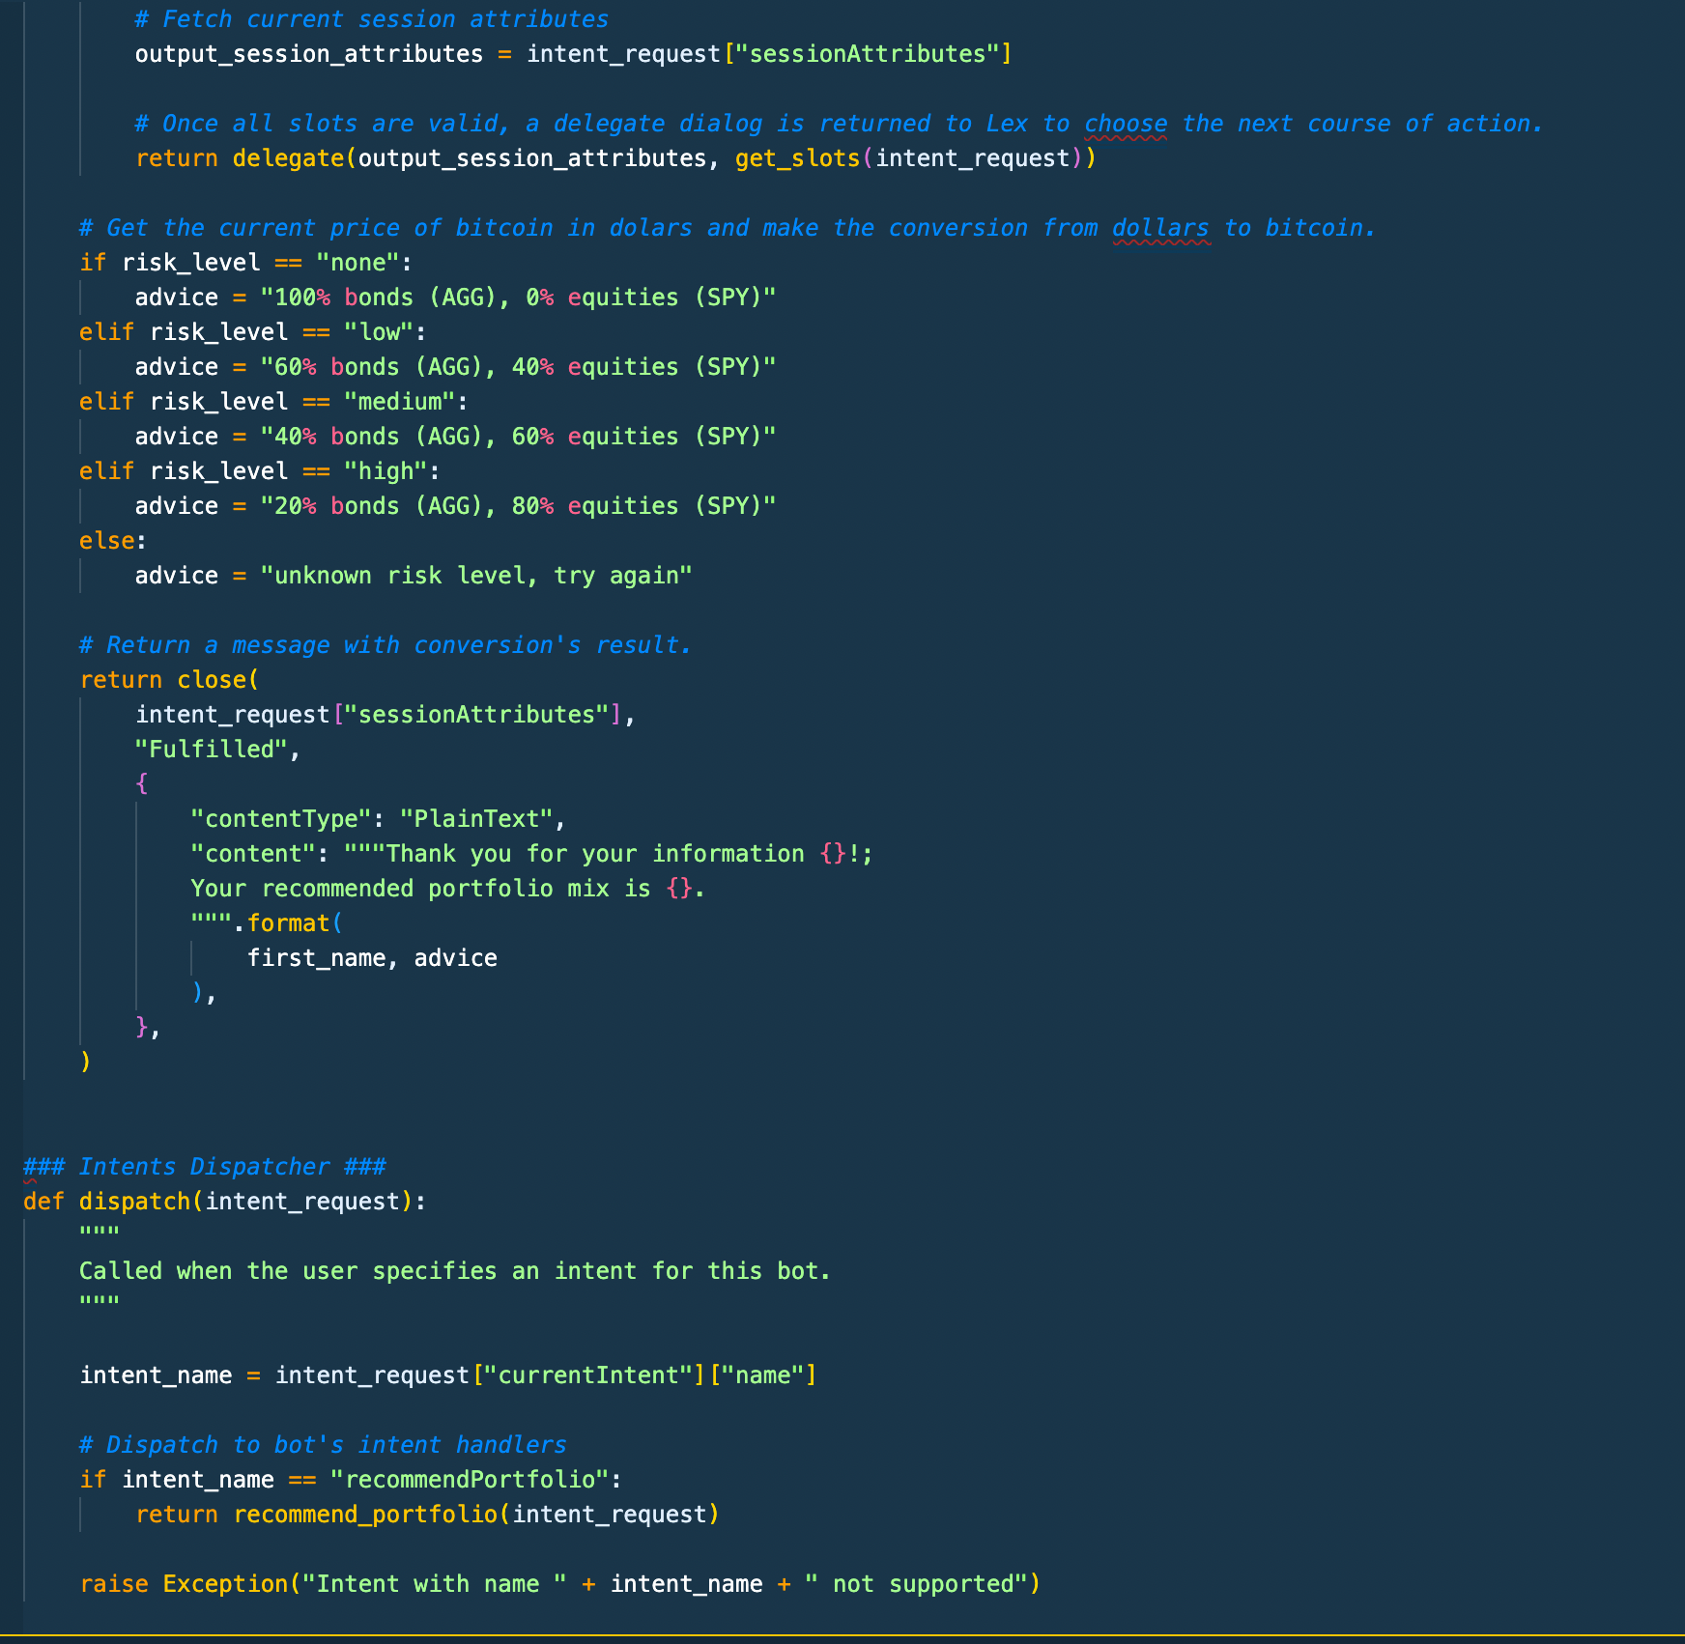
Lambda Fulfillment Code for LEX v1

Slide 18
Next Steps
Debug V2 Lambda
Include additional intents
Phase I ML Recommender will be clustering users on holdings vs targeted risk clusters
We will need Mutual Fund, ETF holdings
We believe that we want to bring the nurses into a mean position for retirement and for peace of minds

